Slide 1
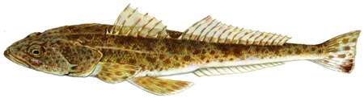
Source: NRE (by Peter Gouldthorpe)
Eleven years of fishery-independent monitoring of Tasmanian sand flathead populations
Alyssa Marshell, Graeme Ewing, Jeremy Lyle, Sean Tracey
ASFB Annual Conference - November 8th 2022

Slide 2
Source: NRE (by Peter Gouldthorpe)
Acknowledgements
Colleagues: Graeme Ewing, Jeremy Lyle, Sean Tracey
Technical staff: Stuart Isles, Robbie Kilpatrick + more
Funding sources: FISHWISE/IMAS/SMRCA & FRDC

Slide 3
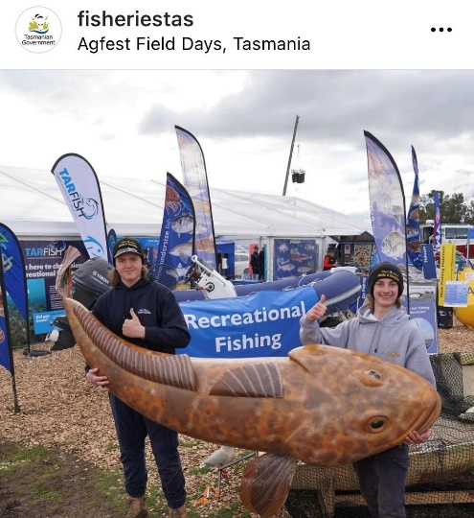
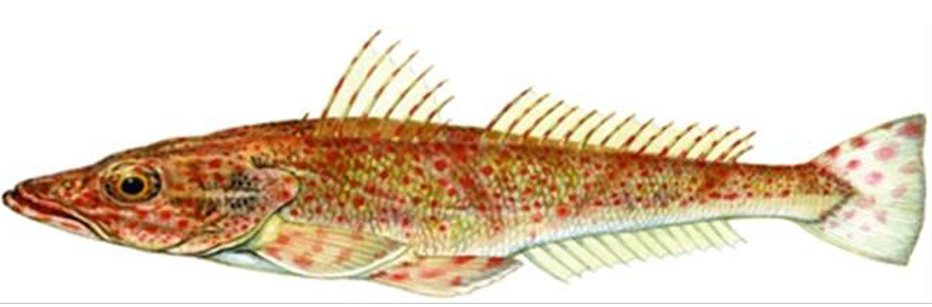
Scalefish Fishery Assessment 2019/20 (Fraser et al 2021)
Species | 2017/18 | 2018/19 | 2019/20
Southern Sand Flathead (Platycephalus bassensis) | DEPLETING | DEPLETING | DEPLETING
Recreational - ~98% of total catch
most important species in rec. fishery
Commercial - ~2% of total catch
handline, by-product - gillnet & Danish Seine
Source: NRE (by Peter Gouldthorpe)
Species | 2017/18 | 2018/19 | 2019/20
Tiger Flathead (Playcephalus richardsoni) | SUSTAINABLE | SUSTAINABLE | SUSTAINABLE
Predominately caught by the commercial sector
Source: NRE (by Peter Gouldthorpe)
Notes:
In late 2015, management changers were introduced to improve status: (1) include in min size limit, introduction of (2) daily bag limit, (3) possession limit. Some evidence of stock recovery but fishing mortality of females remains very high, so high risk of recruitment impairment.
The main impact on Southern Sand Flathead stocks is from the recreational sector with commercial catches estimated to represent less than 2% of the combined total catch. Due to an absence of targeting among commercial fishers, a Southern Sand Flathead fishery-independent survey commenced in 2012 to support the assessment of this species.

Slide 4
Scalefish Fishery Assessment 2019/20 (Fraser et al 2021)
Species | 2017/18 | 2018/19 | 2019/20
Southern Sand Flathead (Platycephalus bassensis) | DEPLETING | DEPLETING | DEPLETING
Recreational - ~98% of total catch
most important species in rec. fishery
Commercial - ~2% of total catch
handline, by-product - gillnet & Danish Seine
Source: NRE (by Peter Gouldthorpe)
Species | 2017/18 | 2018/19 | 2019/20
Tiger Flathead (Playcephalus richardsoni) | SUSTAINABLE | SUSTAINABLE | SUSTAINABLE
Predominately caught by the commercial sector
Source: NRE (by Peter Gouldthorpe)
Notes:
In late 2015, management changers were introduced to improve status: (1) include in min size limit, introduction of (2) daily bag limit, (3) possession limit. Some evidence of stock recovery but fishing mortality of females remains very high, so high risk of recruitment impairment.
The main impact on Southern Sand Flathead stocks is from the recreational sector with commercial catches estimated to represent less than 2% of the combined total catch. Due to an absence of targeting among commercial fishers, a Southern Sand Flathead fishery-independent survey commenced in 2012 to support the assessment of this species.

Slide 5
Southern Sand Flathead
(state-assessed)
Scalefish Fishery Assessment 2019/20 (Fraser et al 2021)
Species | 2017/18 | 2018/19 | 2019/20 | 2020/21
Southern Sand Flathead | DEPLETING | DEPLETING | DEPLETING | DEPLETED
Assessment data
Commercial catch, effort, CPUE
fishery-independent surveys since 2012
size & age structure
Growth rates, mortality, CPUE
Main fishing areas depleted
Very high fishing mortality, especially females
Notes:
In late 2015, management changers were introduced to improve status: (1) include in min size limit, introduction of (2) daily bag limit, (3) possession limit. Some evidence of stock recovery but fishing mortality of females remains very high, so high risk of recruitment impairment.
The main impact on Southern Sand Flathead stocks is from the recreational sector with commercial catches estimated to represent less than 2% of the combined total catch. Due to an absence of targeting among commercial fishers, a Southern Sand Flathead fishery-independent survey commenced in 2012 to support the assessment of this species.

Slide 6
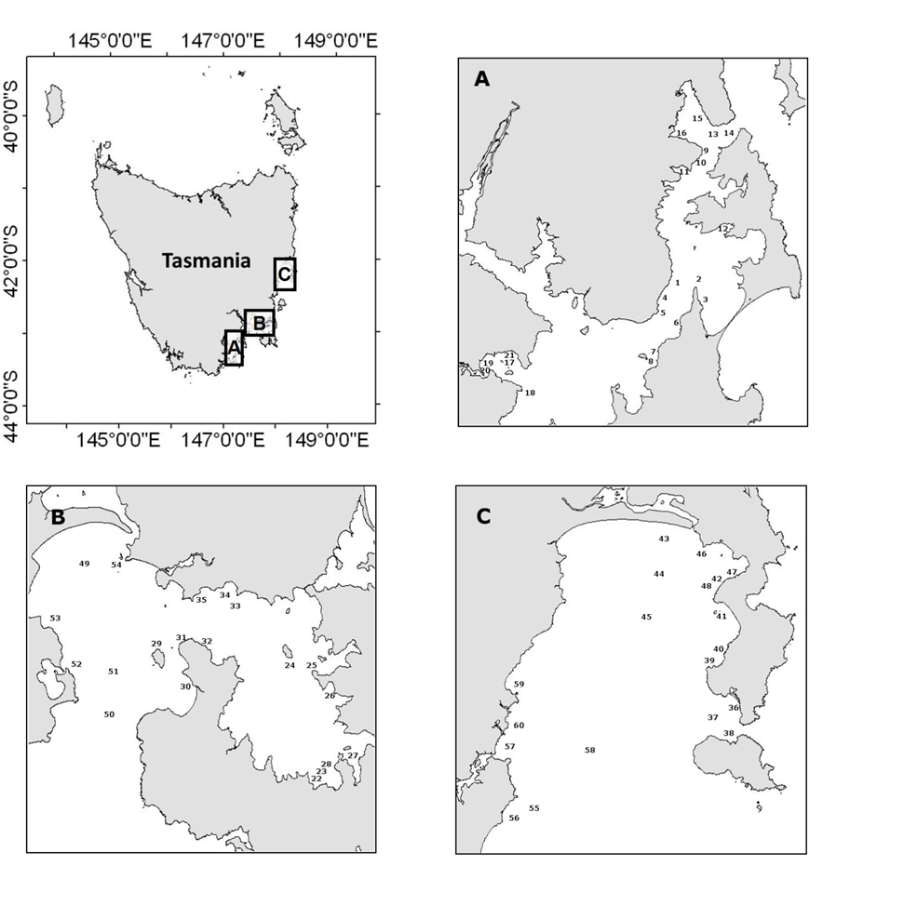
South-east annual survey
3 regions of highest rec. importance
~20 sites per region
spatial coverage
range of habitats
Peak catchability (Jan-Mar)
3 main funding sources
Year | Project/Funding
2012 | FISHWISE
2013 | Sth Babel
2014 | Pot Boil
2015 | IMAS/SMRCA
2016
2017
2018
2019
2020
2021 | FRDC
2022 | FRDC
2023
Notes:
Concerns surrounding the abundance of Southern Sand Flathead led to the establishment of an annual fishery-independent survey, which has been conducted since 2012 (Ewing and Lyle 2020). The survey uses fishing gear and targeting practices typical of recreational fishers in areas of significant effort, including the D’Entrecasteaux Channel, Norfolk Bay and Frederick Henry Bay, and Great Oyster Bay, with sampling occurring during February and March. Fishing was generally conducted over three (not necessarily consecutive) days per region with 19-21 standard sites fished in each region. The sampling sites represent a range of suitable habitats IMAS Report - Page 69 Tasmanian Scalefish Fishery Assessment 2019/20 (including depths) for targeting Southern Sand Flathead, providing wide spatial coverage in each region.

Slide 7
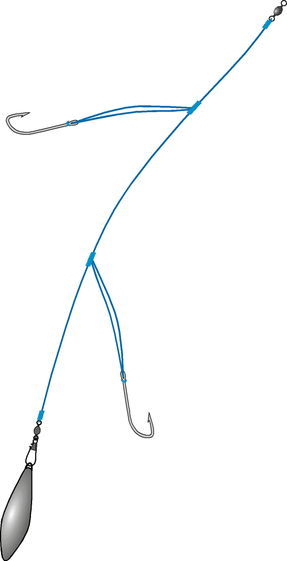
Sampling method
Paternoster rig
Up to 3 fishers - 30 mins/site
First 100 fish/region retained
Subsequent catches sized, tagged & released
Bycatch ID & sized
Retained sand flathead
size
weight
sex
gonad stage/weight
age estimate
Year | N
Year | Aged | Sized
2012 | 307 | 833
2013 | 248 | 995
2014 | 278 | 350
2015 | 311 | 562
2016 | 282 | 418
2017 | 316 | 709
2018 | 303 | 902
2019 | 299 | 654
2020 | 301 | 753
2021 | 321 | 915
2022 | 301 | 493
Total | 3268 | 7584
Notes:
Concerns surrounding the abundance of Southern Sand Flathead led to the establishment of an annual fishery-independent survey, which has been conducted since 2012 (Ewing and Lyle 2020). The survey uses fishing gear and targeting practices typical of recreational fishers in areas of significant effort, including the D’Entrecasteaux Channel, Norfolk Bay and Frederick Henry Bay, and Great Oyster Bay, with sampling occurring during February and March. Fishing was generally conducted over three (not necessarily consecutive) days per region with 19-21 standard sites fished in each region. The sampling sites represent a range of suitable habitats IMAS Report - Page 69 Tasmanian Scalefish Fishery Assessment 2019/20 (including depths) for targeting Southern Sand Flathead, providing wide spatial coverage in each region.

Slide 8
Size structure
D’Entrecasteaux Channel (A) Frederick Henry / Norfolk (B) Great Oyster Bay (C)
Some gains from ↑MSL
(2015 ↑ 300 to 320 mm)
Most below MSL (320mm)
Low abundance - legal sized fish
Smaller in Channel (A)
Larger in Great Oyster Bay (C)
Notes:
Size composition
Length frequency histograms from the fishery-independent survey indicate that the majority of Southern Sand Flathead in the D’Entrecasteaux Channel and Norfolk Bay and Frederick Henry Bay were below the minimum size limits, which indicate a low abundance of legal sized fish. Fish caught in Great Oyster Bay during previous surveys typically showed a higher proportion of legal sized fish than other regions. However, catches in the 2020 survey at Great Oyster Bay showed a lower proportion of legal sized fish than any other year (Figure 39).

Slide 9

Sex/age structure
A
B
C
2012-
Most < 5 years old
Few older age classes
Older fish mostly male
More, older fish at C
Some gains from ↑MSL
2013-
2014-
2015-
2016-
Age frequency
Black = males
Grey = females
2017-
Notes:
Age composition
Age frequency histograms from the fishery-independent survey indicate that fish younger than five years old represent the dominant age classes of Southern Sand Flathead, especially in the D’Entrecasteaux Channel, Norfolk Bay and Frederick Henry Bay (Figure 40). Older age classes up to 12 years tend to be rare in all regions, but in previous surveys were least obviously so in Great Oyster Bay, where large fishes above the legal size limit were most common. However, in the 2020 survey, catches in Great Oyster Bay showed a relative rarity of older, legal sized fish. It is further evident that the abundance and proportion of females declines notably in the older age classes most likely reflecting an earlier fishery exposure due to the faster growth of females.

Slide 10
Sex/age structure
A
B
C
2018-
Most < 5 years old
Few older age classes
Older fish mostly male
Signs of recruitment variation
Older fish at C - less in 2020-21
2019-
2020-
2021-
Age frequency
Black = males
Grey = females
2022-
Notes:
Age composition
Age frequency histograms from the fishery-independent survey indicate that fish younger than five years old represent the dominant age classes of Southern Sand Flathead, especially in the D’Entrecasteaux Channel, Norfolk Bay and Frederick Henry Bay (Figure 40). Older age classes up to 12 years tend to be rare in all regions, but in previous surveys were least obviously so in Great Oyster Bay, where large fishes above the legal size limit were most common. However, in the 2020 survey, catches in Great Oyster Bay showed a relative rarity of older, legal sized fish. It is further evident that the abundance and proportion of females declines notably in the older age classes most likely reflecting an earlier fishery exposure due to the faster growth of females.

Slide 11
Growth
Females grow faster to larger maximum size
Notes:
Age estimates were generated for 321 Sand Flathead sampled in 2021. The oldest individuals were two 10 + year old males captured in Frederick Henry Bay (307mm and 291 TL). The largest fish aged was 400mm TL (8+ year old) female captured in Great Oyster Bay. The youngest fish encountered were 2+ year olds collected in the D’Entrecasteaux Channel, Frederick Henry Bay and Great Oyster Bay. (Table 5). The abundance and proportion of females declines rapidly in the older age classes reflecting the earlier exposure to the fishery of females due to their faster growth rate (Fig. 5) (Ewing and Lyle 2014).
Parameter estimates for the Von Bertalanffy growth functions are presented in Table 6 and length-at-age data are presented by region in Fig. 6. Females grow more quickly to higher asymptotic lengths than males in each region. Estimated age at the MSL (320 mm TL) also display clear sex differences, with the oldest average female age at MSL (11 years in D’Entrecasteaux Channel) and male estimated age never reaching the MSL in any region.

Slide 12
Growth
A
Females - faster to ↑max size
Channel slower
B
C
Notes:
Age estimates were generated for 321 Sand Flathead sampled in 2021. The oldest individuals were two 10 + year old males captured in Frederick Henry Bay (307mm and 291 TL). The largest fish aged was 400mm TL (8+ year old) female captured in Great Oyster Bay. The youngest fish encountered were 2+ year olds collected in the D’Entrecasteaux Channel, Frederick Henry Bay and Great Oyster Bay. (Table 5). The abundance and proportion of females declines rapidly in the older age classes reflecting the earlier exposure to the fishery of females due to their faster growth rate (Fig. 5) (Ewing and Lyle 2014).
Parameter estimates for the Von Bertalanffy growth functions are presented in Table 6 and length-at-age data are presented by region in Fig. 6. Females grow more quickly to higher asymptotic lengths than males in each region. Estimated age at the MSL (320 mm TL) also display clear sex differences, with the oldest average female age at MSL (11 years in D’Entrecasteaux Channel) and male estimated age never reaching the MSL in any region.

Slide 13
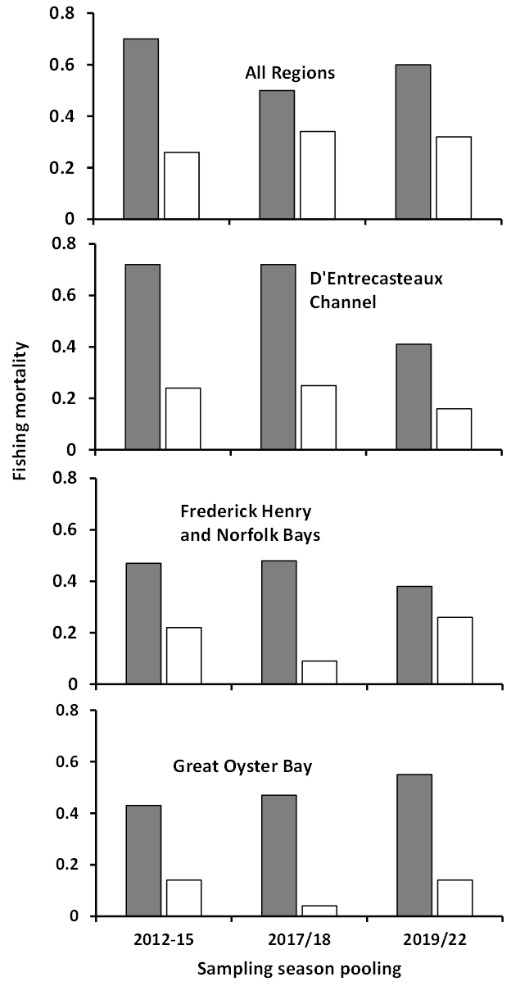
Fishing mortality
↑ mortality of females from ↑ growth
Effect from ↑MSL during recovery
Channel ↓females – bag/size limit?
GOB ↑females – cohort structure?
Males relatively stable through time
Grey = females
White = males
Notes:
Fig. 8. Sand Flathead fishing mortality estimates by region for the years prior to the increase in the MSL (2012-15), following the increase (2017/18) and in the last three seasons (2019-21).
Estimates of F from the periods prior to the increase in the MSL (2012-15), immediately following the increase (2017 & 2018), and in the three most recent assessment years (2019,2020 & 2021), are presented in Table 7 and Fig. 9. The overall fishing mortality rate for females was highest prior to the increase in the MSL (over three times M) but has stabilised at a lower level (about two times M) in subsequent years (Table 7). Fishing mortality for males has tended to remain stable through time, at a rate slightly higher than M. While there is some regional variability in mortality rates the trends through time are relatively consistent (Fig. 8).
Mortality (SA 2019/20): Estimates of fishing mortality F from the period prior to the increase in the minimum size limit (2012–2015), after the expected recovery period (2017–2018), and in the last two assessment years (2019–2020) are presented in (Table 2) below. The overall fishing mortality rate for females was highest prior to the increase in the minimum size limit (over three times natural mortality (M)) but has stabilised at a lower level (about two times M) in subsequent years (Table 2). Fishing mortality for males has tended to remain stable through time, at a rate slightly higher than M. While there is some regional variability in mortality rates the trends through time are relatively consistent.

Slide 14
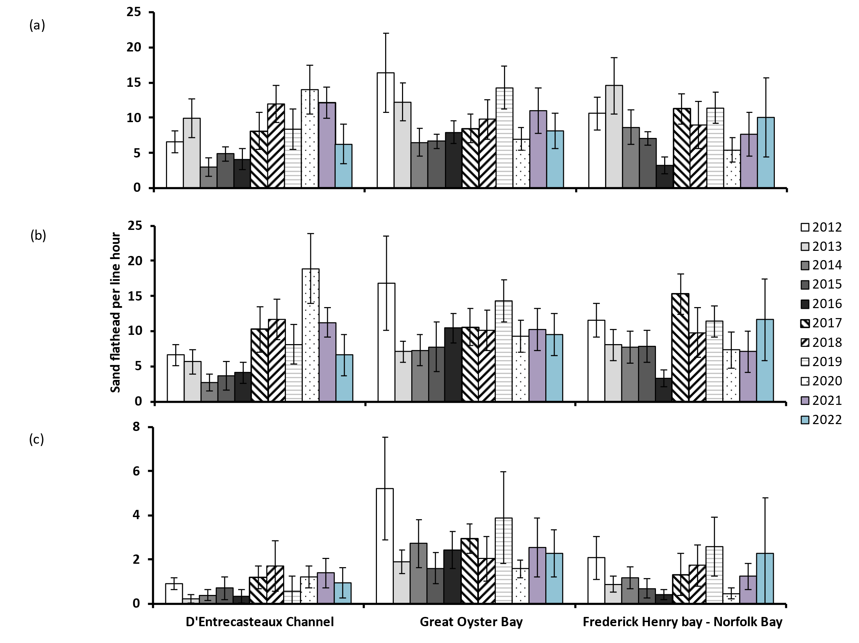
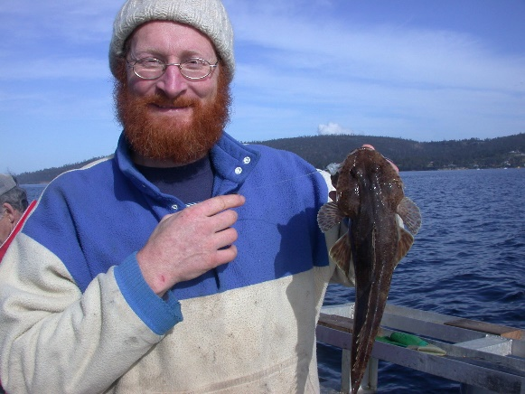
Catch rates
Raw catch rates
Declined to lowest levels 2014-16
Recovered in following years
Channel – standardised rates declined - 2020 to 2022
Standardised
Standardised (>320 mm MSL)
Notes:
Fig. 9. Mean catch rates (fish per line hour) by region and year for Sand Flathead: (a) raw catch rates; (b) standardised catch rates; and (c) standardised catch rates for fish above the 320mm MLS. Error bars represent 95% confidence intervals.
Catch rates in each of the regions initially declined to their lowest levels between 2014 and 2016 before recovering to levels comparable to, or greater than, those in 2012 in the following years (Fig. 9). Standardised catch rates yielded in 2021were similar to 2020 rates with the exception of the D’Entrecasteaux Channel where standardised rates fell dramatically from 2020 levels (Fig. 9).

Slide 15
FRDC – 2021-22 sampling
Regions of highest rec effort
Same method
3 sample seasons (2021 – 2023)

Slide 16
Size structure
2021
2021 + 2022 (pooled)
Offshore – larger mean size
Stanley – larger mean size
Population centres – smaller mean size
Notes:
Size structure: Sampling yielded 1745 Sand Flathead with very low bycatch (Table 1). A summary of the size structure of the Sand Flathead captured is presented in Table 2. The smallest individual encountered was 170mm TL and was captured in the Tamar Estuary. The largest fish encountered was 430mm TL and was captured in coast adjacent to Stanley.
Except for the Stanley region, Sand Flathead catches were dominated by undersized fish and, females dominated the catch of legal sized fish in every region (Tables 3 and 4) (Fig. 2).

Slide 17
Sex/age structure
2021 + 2022 (pooled)
Most fish less than 7 yrs old
Tamar most 2-3 yrs old
Older fish mostly male
Stanley – less depletion
Age frequency
Black = males
Grey = females
Notes:
Age structure: Age estimates were generated for 773 Sand Flathead. The oldest individual was a 12-year-old male captured on the coast adjacent to Stanley (346mm). The largest fish aged was 425mm TL (8+ year old) female also captured in the Stanley region. The youngest fish encountered were 1+ year olds collected in the Mercury Passage, Bridport, and Tamar regions (Table 5).
The abundance and proportion of females declines rapidly in the older age classes reflecting the earlier exposure to the fishery of females due to their faster growth rate (Fig. 3) (Ewing and Lyle 2014).
Length-at-age data are plotted by region in Figs. 4a and 4b, and parameter estimates for the Von Bertalanffy growth functions are presented in Table 6. Females grow more quickly to higher asymptotic lengths than males in every region. Estimated age at the MSL (320 mm TL) also display clear sex differences (Table 6).

Slide 18
Conclusions – Fishery-Independent Surveys
Overall:
Females more vulnerable to fishing depletion
Size & age structure in most regions
Mortality by sex
ALL data indicates stock DEPLETION
However – there is spatial variation
Temporal comparisons - SE TAS:
Some signs of recovery – 2015 management changes – most obvious – Channel (SE)
Spatial comparisons - FRDC 2021-22 TAS-wide sampling:
Variations in size structure
Offshore and proximity to population center effects
Stanley (NW) least affected
Notes:
2015 = 300 mm –> 320 mm (TL); Bag limit 30 -> 20 fish
INTERIM: Precautionary -> catch limits + boat limit? Or further size limits? Implement Nov 2022 - Nov 2024 (then we will have more info about fishery & size limits)
Size limits enforced but fishing mortality is still high
Therefore, catch limits are probably a good idea to reduce fishing mortality
Regionalisation?

Slide 19
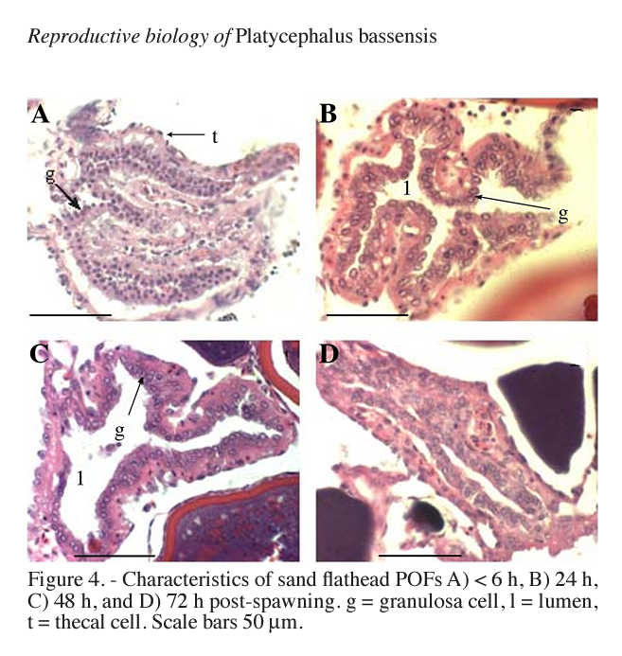
Ongoing…(FRDC)
Reproductive biology sampling
Oct – Dec 2022
Northern vs Southern sites
Snapshot – may lead to further studies?
Compilation & review of historical datasets
Virtual population models (James Haddy)
Stock assessment tool (Nils Krueck)
Exploring length-based & data-poor assessments
Bani et al 2009
Sampling = 2001/02

Slide 20
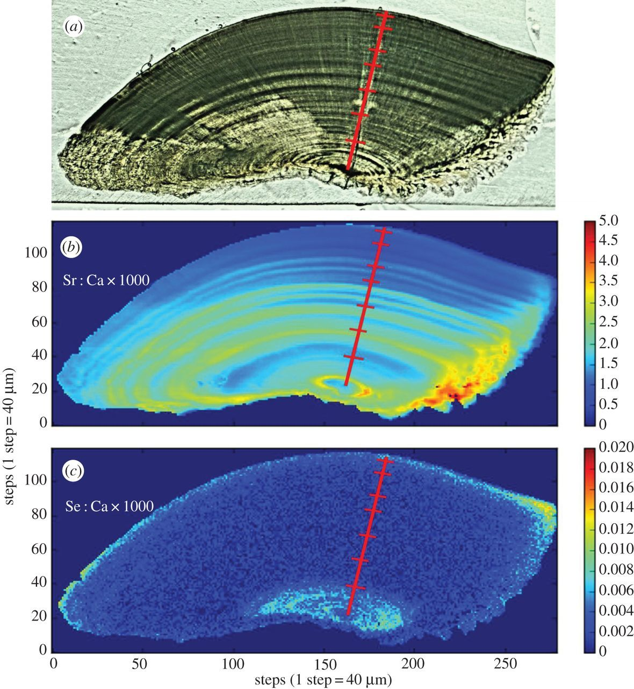
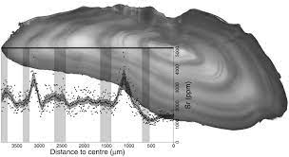
Ongoing…(FRDC)
Pilot Study - Otolith Microchemistry
- Can multi-element trace signatures discriminate flathead across sites & years?
Northern vs Southern sites
Oceanic (offshore) vs. Nearshore (channel) sites
2 age classes per site
Laser target primordial & edge otolith material
Primordial signature - discriminate natal origin
Edge = training dataset for known location (capture location)
If successful – expand –> more individuals, sites, years
(Hermann et al 2016)

Slide 21
Ongoing…
Tassie Fish Frame Collection Program
October 2019 – June 2022
Total sand flathead donated = 318
Males = 26
Females = 228
Mean Size (TL) = 349 +/- 1.8 (SE)

Slide 22
Thank you
Alyssa Marshell
alyssa.marshell@utas.edu.au
Source: NRE (by Peter Gouldthorpe)
CRICOS Provider Code: 00586B

